Slide 1

A long time ago, in a galaxy
far, far away...

Slide 2
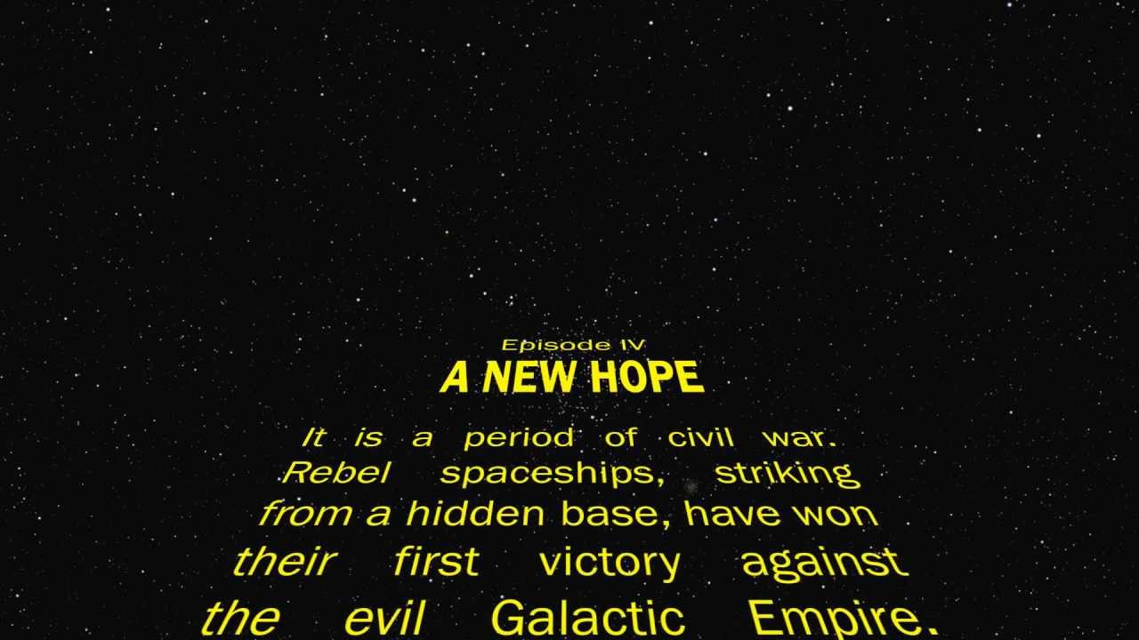
!!! NOT !!!

Slide 3
Who we are...
Two dudes...
Arvind
Jonathan

Slide 4
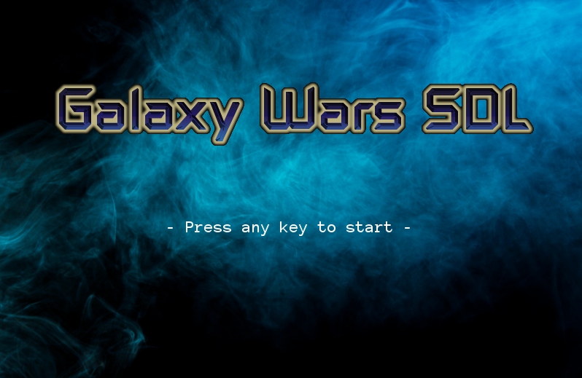
Board games are too boring...
We want...
Action
Guns
Ships
A tint of sci-fi
Star Wars fandom
...

Slide 5
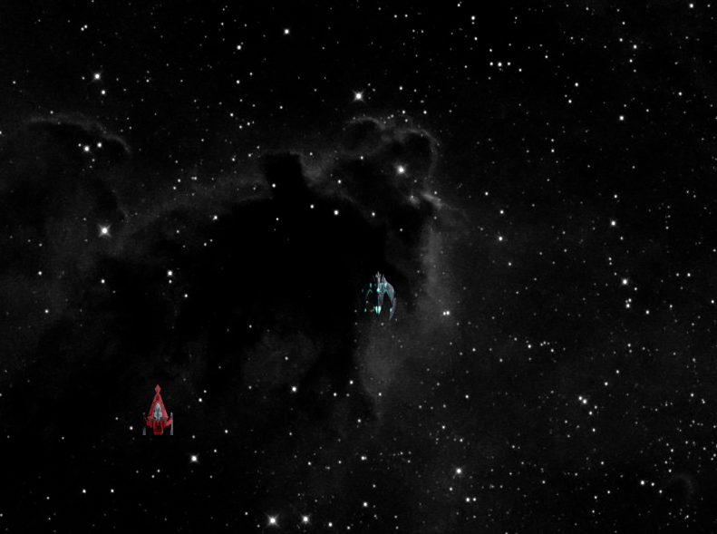
How it is made
Perl SDL (100%!)
Various SDL libraries
imagemagick (teehee)

Slide 6
About: Movement
Main: Arrow keys
✔ Diagonal movement
SDL can detect key up/down, so it is possible to press two keys at once
✔ Boundary constraint
typical coordinate detection

Slide 7
About: Gunfires
A bit tricky. Try to ‘swerve’ the gunshot as the player ship maneuvers -> More realistic/Increase difficult (jk)
✔ Weapon ‘upgrade’, increases every 200 points (we set it at 100 for demo)

Slide 8
About: Enemy Spawn
✔ Random set of coordinates within bounds
✔ Random ‘shield’ generation

Slide 9
About: Collision Detection
Between player & enemy
Between gunshots & enemies
Take into account of sprite pixel size

Slide 10
Challenges
SDL has poor documentation :(
Timeframe is short, we could have made the game more fun
Hard to find suitable sprites

Slide 11
Future Development
More weapons!
More ships!
More enemies
More levels!
Last but not least: Better AI! (path following)
...

Slide 12
Credits
BGM: Star Wars Theme (8-bit) by Crig (https://soundcloud.com/crig-1/star-wars-theme-8bit?in=crig-1/sets/star-wars-music)

